Slide 1
Tutorial 12 –RNN-LSTM
KDM- Spring 2020

Slide 2
Goal
Develop an LSTM Model using python
Perform text classification with this LSTM model

Slide 3
Data
The SMS Spam Collection is a set of SMS tagged messages that have been collected for SMS Spam research.
It contains 5,574 SMS messages in English, tagged ham (legitimate) or spam.
The files contain one message per line. Each line is composed by two columns: v1 contains the label (ham or spam) and v2 contains the raw text.

Slide 4
Problem statement
Binary classification
Given a SMS, can it be automatically classified as spam or ham?

Slide 5
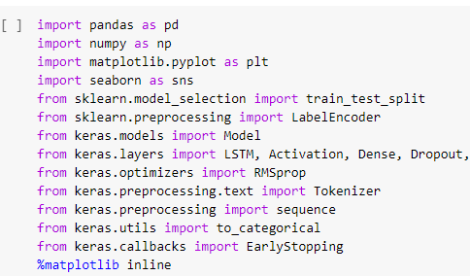
Import the necessary libraries

Slide 6
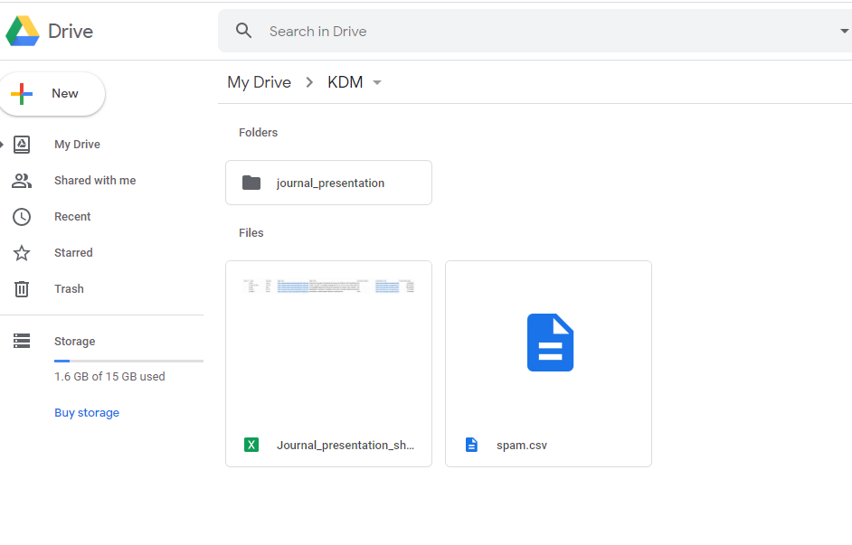
Dataset
Save the data file (spam.csv) on your google drive.

Slide 7
Mounting the google drive on Colab
Run the following code on the colab and copy and paste the key from the link that will be displayed after running the code.

Slide 8
Reading the Data
Read the data as pandas data frame
The file path should be: '/content/drive/ + location of the data on your google drive’

Slide 9
Filtering data
Drop irrelevant columns “Unnamed: 2, Unnamed: 3, Unnamed: 4’’

Slide 10

Data analysis
Understand the distribution better.
Analyze the labels and look at the distribution of each class.
A visualization chart can help in analyzing the data

Slide 11
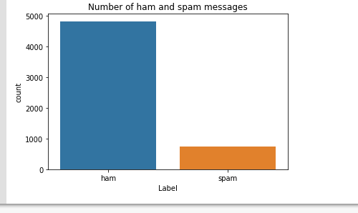
Class Imbalance
The data is unbalanced.
There are more legitimate messages than spams
ham = 4825 messages and spam= 747 messages
~87% of data is ham class and ~13% is spam class

Slide 12
How to solve class imbalance
Usually there are various techniques to handle class imbalance in the data, but the two widely used one are:
Random Oversampling: Randomly duplicate examples in the minority class.
Random Undersampling: Randomly delete examples in the majority class.
This will be the ICP task

Slide 13
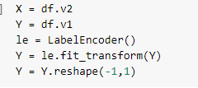
Preprocessing
Create input and output vectors.
Process the labels.

Slide 14
Preprocessing
Split into training and test data.
Notice the test set is 15% and training is 85%

Slide 15
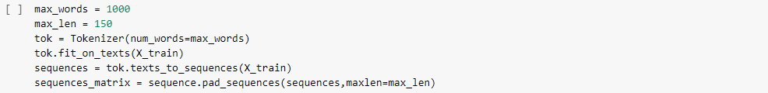
Preprocessing
Tokenize the data and convert the text to sequences.
Add padding to ensure that all the sequences have the same shape.
There are many ways of taking the max_len and here an arbitrary length of 150 is chosen.

Slide 16
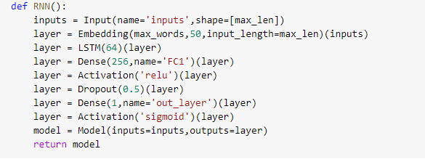
RNN structure
Define the RNN structure.

Slide 17
Model
Call the function and compile the model.

Slide 18
Fitting the model
Fit on the training data.

Slide 19
Processing the test data
Process the test set data.

Slide 20
Model Evaluation
Evaluate the model on the test set.

Slide 21
ICP
Solve the data imbalance issue with either random Undersampling or random oversampling.
Report on new class ratio
Compare the model performance on this modified data.

